Slide 1
BITS Pilani presentation
K.Anantharaman
kanantharaman@wilp.bits-pilani.ac.in

Slide 2
SE ZG 544 , Agile Software Process
Module-4 - Agile Methodologies

Slide 3
Module-4 Topics
Agile Methods
Scrum
XP
Lean
Kanban

Slide 4
Agile Methodologies
Scrum, Kanban, XP, Lean

Slide 5
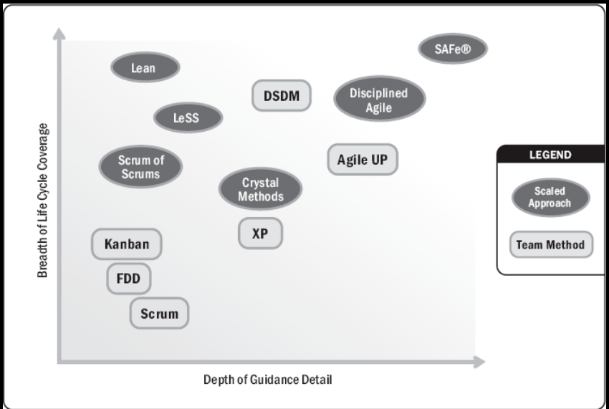
Agile Methods
Source :Agile Practice Guide by Project Management Institute, published by Project Management Institute, 2017

Slide 6
Scrum

Slide 7
Scrum
History and Origins
Scrum is a single-team process framework used to manage product development.
Empirical process framework
Empirical method : A process how you think something works, test it out, reflect on the experience, and make the proper adjustments
Inspection, Adaption, Transparency
Based on adaptive life cycle method (Iterative and Incremental)
Scrum is the most common approach to agile for good reasons:
The rules of Scrum are straightforward and easy to learn and teams all around the world have been able to adopt them and improve their ability to deliver projects.
Using Scrum effectively is not so simple

Slide 8
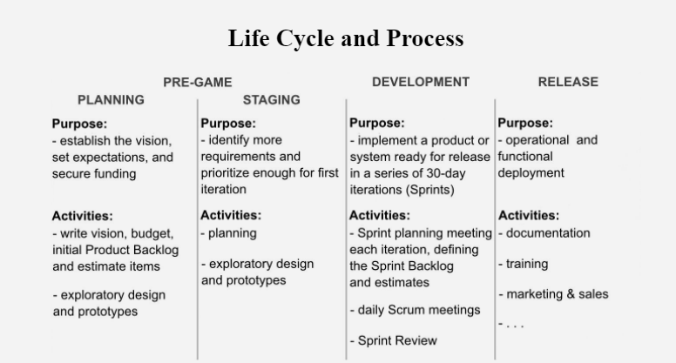
Scrum Life Cycle Process
Source: So, What's The Big Deal About Scrum?,by by André Akinyele,2019

Slide 9
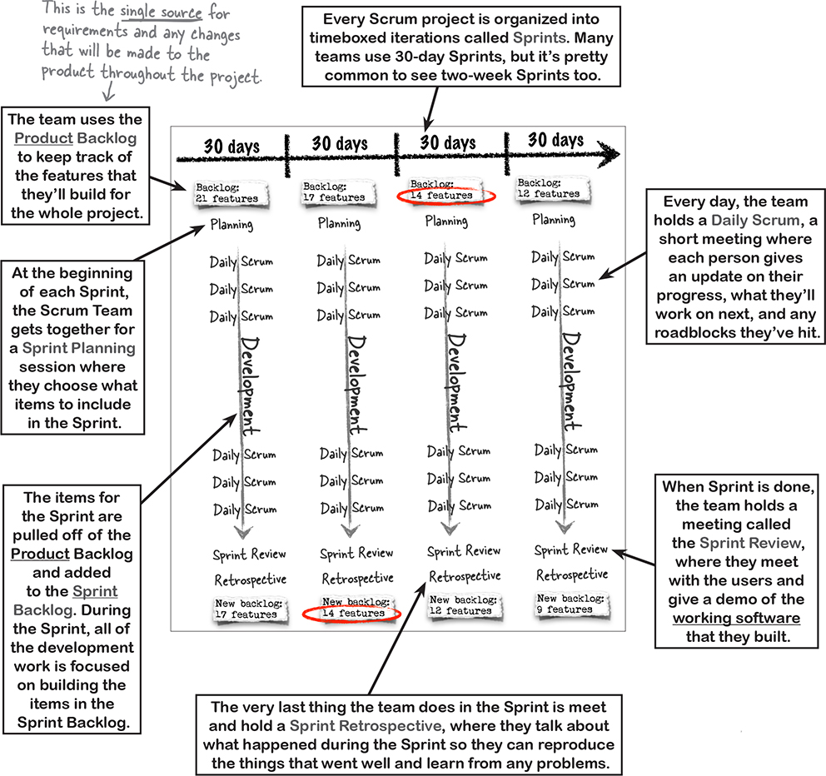
Scrum Project Life cycle
2 weeks to 4 weeks Sprints
The Scrum events:
The Sprint
The Sprint Planning
The Daily Scrum
The Sprint Review
The Sprint Retrospective
1
2
The Scrum Artifacts:
The Product Backlog
The Sprint Backlog
The Product Increment
Increment
Increment
Increment
Increment
4
The Scrum Roles:
The Product Owner
The Scrum Master
The Team
3
5
PSI-Potentially shippable increment
Source:Head First Agile by Jennifer Greene; Andrew Stellman,
Published by O'Reilly Media, Inc., 2017

Slide 10
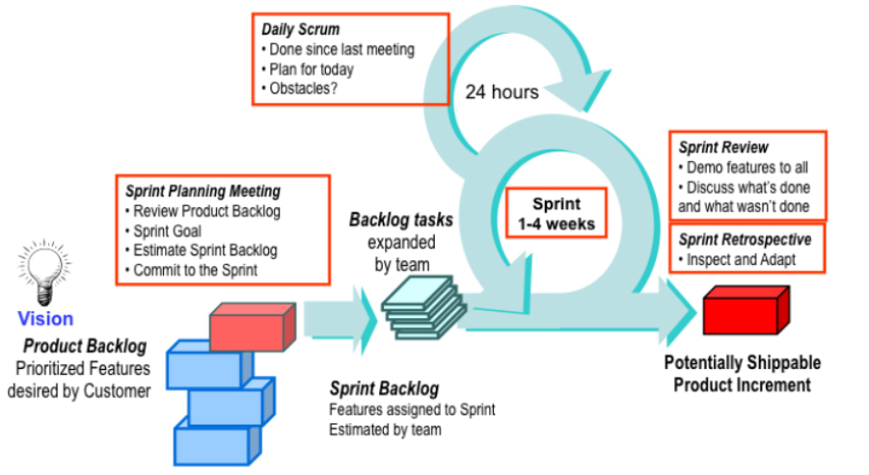
Scrum Project Lifecycle
Grooming
Agile project management with Scrum

Slide 11
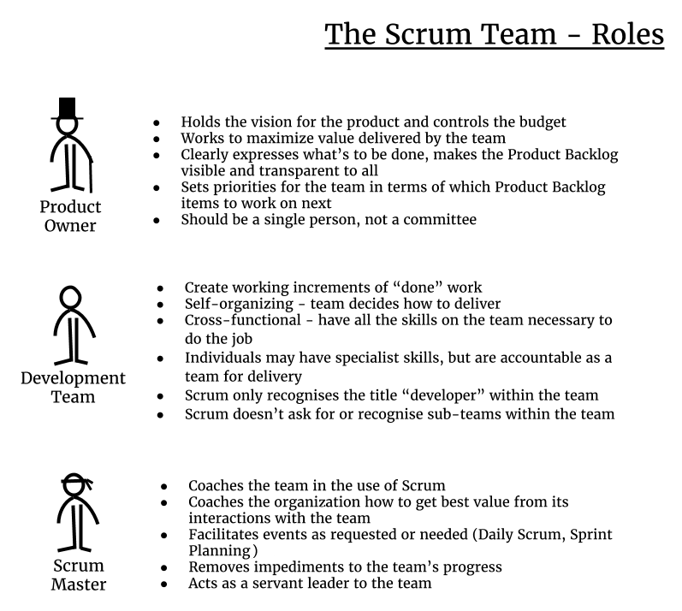
Scrum Roles
Source: The Agile Developer's Handbook, by Paul Flewelling,Published by Packt Publishing, 2018

Slide 12
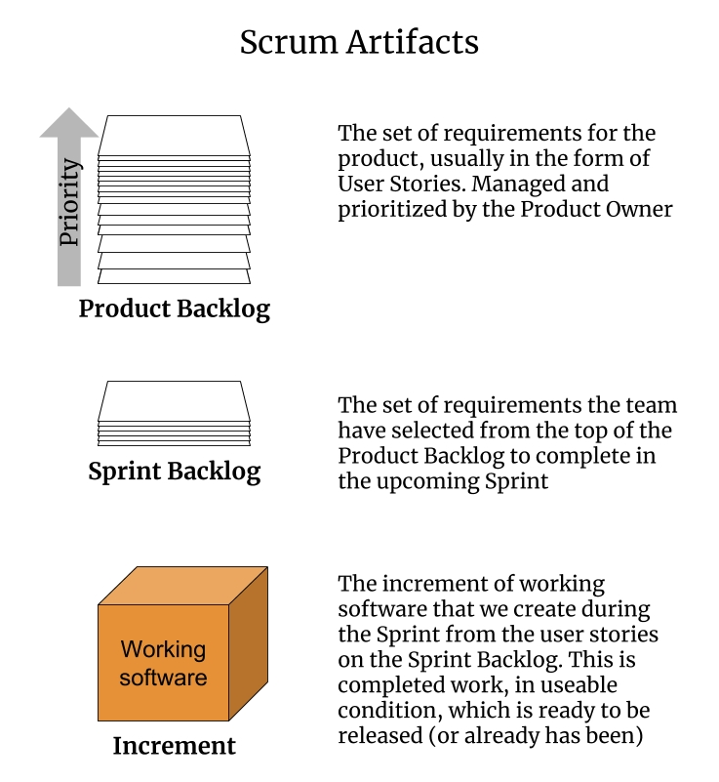
Scrum Artifacts
Source: The Agile Developer's Handbook, by Paul Flewelling,Published by Packt Publishing, 2018

Slide 13
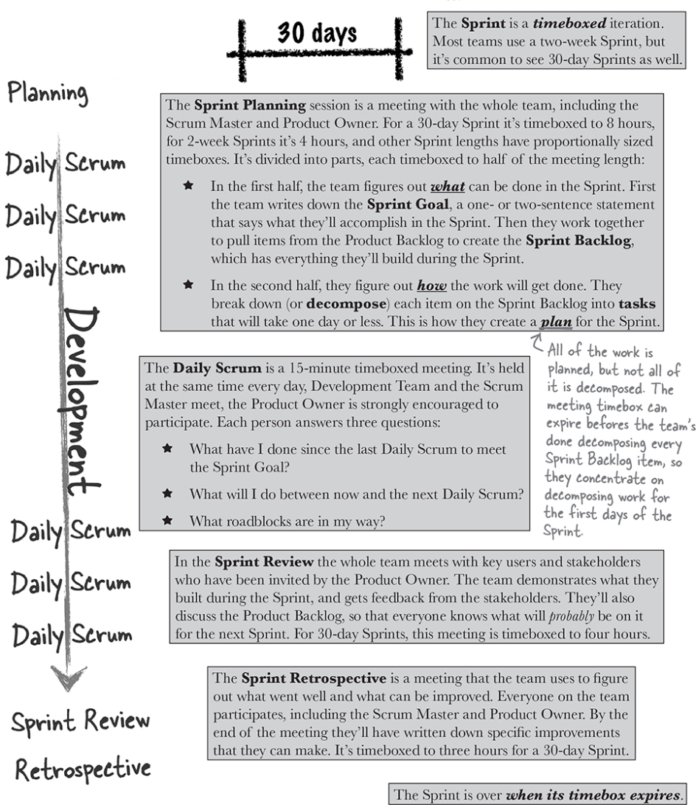
Sprint Events/Ceremonies
2 wks. to 4wks.
Source: Head First Agile by Jennifer Greene; Andrew Stellman,
Published by O'Reilly Media, Inc., 2017

Slide 14
Quiz
Set1

Slide 15
XP- Extreme Programming
Agile Foundations - Principles, practices and frameworks, by Peter Measey
Published by BCS Learning & Development Limited, 2015
Scaling Software Agility: Best Practices for Large Enterprises by Dean Leffingwell
Published by Addison-Wesley Professional, 2007

Slide 16
What is eXtreme Programming?
XP is a widely used agile software development method developed by Ken Beck,2000.
Key Practices:
A team of five to 10 programmers work at one location with customer representation on site.
Development occurs in frequent builds or iterations, each of which is releasable and delivers incremental functionality.
Requirements are specified as user stories, each a chunk of new functionality the user requires.
Programmers work in pairs, follow strict coding standards, and do their own unit testing.
Requirements, architecture, and design emerge over the course of the project.
XP is prescriptive in scope. It is best applied to small teams of under 10 developers, and the customer should be either integral to the team or readily accessible
What is Extreme?
– Practices are to its purest, simplest form, P-Programming- innovative and sometimes controversial practices for the actual writing of software.

Slide 17
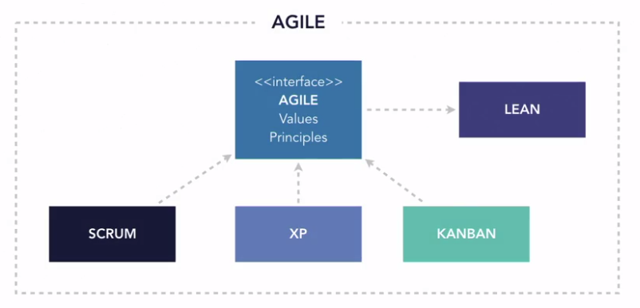
How XP fits in Agile
Source :Lynda.com/XP overview

Slide 18
XP Theme
The primary theme of XP is that if something hurts, do it all the time.
If code reviews are good, we’ll review code all the time (pair programming).
If testing is good, everybody will test all the time (unit testing), even the customers (functional testing).
If design is good, we’ll make it part of everybody’s daily business (refactoring).
If simplicity is good, we’ll always leave the system with the simplest design that supports its current functionality (the simplest thing that could possibly work).
If architecture is important, everybody will work at defining and refining architecture all the time (metaphor).
If integration testing is important, we will integrate and test several times a day (continuous integration).
If short iterations are good, we will make the iterations really, really short—seconds and minutes and hours, not weeks and months and years.
The Extreme case!
Source :Lynda.com/XP overview

Slide 19
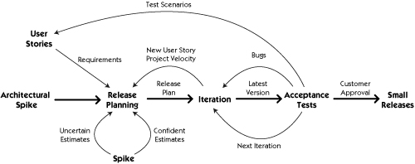
A visual process model for XP

Slide 20
XP Core Values
Communication (Key to Product Quality)
Planning, Estimation, Co-location, Pair-programming, Unit tests
Feedback (Ensures stay on course)
Short iterations, On-site customer, State of functional tests shows the current development of the project and unit tests shows state of the code base.
Simplicity(Simple design has least bugs and easy to modify
‘‘Do the simplest thing that could possibly work” philosophy, focusing on solutions for the current iterations of work and contribute to rapid development of stories.
No extra functionality.
Respect (Respect each other ideas we are creating together)
Respecting oneself and other team members in the team
Courage (It takes courage to do things you know are right)
It takes courage to highlight issues/Architecture flaw even late in the day, it takes courage to throw away the code when you recognize that there is a better design. takes courage to refactor the another developer code, Courage to fail. Change.

Slide 21
Basic XP principles
Humanity
XP’s first principle is the simple principle of humanity.
Focus on people, empower people, provide benefits to people, and you and your people are likely to find a way to a process that engages people in working together and solving problems in new and innovative ways.
Rapid feedback
Seek feedback at the earliest possible moment, interpret it appropriately and apply learning from it back into the system. In practice this is achieved by the different Planning, testing activities, direct communication with the customer ,sharing of knowledge and code across the whole team.
Assume simplicity
Choose the simplest solution that could solve the problem. By applying the principle of simplicity to development, design and code becomes leaner, resulting in quicker development.
The phrase ‘You Ain’t Gonna Need It’ (YAGNI) was coined to embody this principle., DRY (Don’t Repeat Yourselves)

Slide 22
XP Principles …
Incremental change/Baby Steps
Small manageable steps/tasks. Work incrementally, one/two week iterations
Embrace change
Quality work
An XP team is committed to the principle of doing a good job.
By producing quality work, members of an XP team will be proud of their contribution to the project, which becomes a motivating factor.
Sacrificing quality will only have a negative effect on a project. As one of the fundamental principles of XP, it should not be optional.
Reflection.
Retrospect and improve

Slide 23
Further principles
These principles are more specific to particular situations.
Teach learning
Small initial investment (Focus on innovation)
Play to win
Concrete experiments
Open and honest communication
Work with people’s instincts, not against them
Accepted responsibility
Local adaptation
Travel light
Honest measurement

Slide 24
Key XP Practices
The planning game:
Release planning: (Monthly or Quarterly)
User-stories, Customer responsibility, Stakeholders
Exploration phase (Elaboration, estimation – Whole Team activity)
Commitment phase (Based on the business value, combined with the estimates, the customer will decide the scope and date of the next release)
Steering phase (Weekly cycle - executed over the remaining time till release)
Feedback from each iteration’s delivery is used to steer the project. Both the customer and team have opportunities during the steering phase to make changes.

Slide 25
XP Practices
Small releases
Small releases can start to gather feedback that can be used in steering the system’s subsequent development, as well as potentially delivering business value early.
Metaphor
Used to form a form an understanding of the system by whole team through the project
Example: Shopping cart as metaphor to discuss e-Commerce application requirements.
Simple design
Testing
All stories are to have automated functional tests
Indications of progress as new tests are shown to be successful.
Confidence in the system as existing tests are shown to be successful.
Team is driven by tests , Test Driven development (TDD)

Slide 26
XP Practices …
Refactoring
Refactoring is the process of simplifying the internal structure of code without affecting its external behavior
TDD = Test first + Refactoring
Pair programming
Code is created by two developers using one machine.
When One person codes, other person in in different perspective - about the design, different solutions, how code fits into overall solutions.
After a period of time or at a convenient point, the developers swap places.
Benefits:
Conversation during the process helps to quickly move the solution on.
Knowledge is shared as developers pair with different individuals.
Code is reviewed in real-time; teams that practice pair programming often eschew code reviews.
The practice promotes collective code ownership.

Slide 27
XP Practices …
Collective ownership
Developers can improve any part of the code at any time.
This practice also avoids code becoming owned by individuals, which can lead to bottlenecks in development and poorly designed code.
Continuous integration
The codebase should be integrated and automated tests run frequently.
Developers working locally on their machines should check-in their changes frequently, ensuring that code conflicts are identified and resolved quickly.
10-Minute build
Build, Deploy and Test - all in 10 minutes
Build Server/Integration server – Builds the code automatically - pull the code from the source control system and compiles the integrated code, then deploy the code on a test/stage environment and run automated tests) Example: Jenkins integration server
Continuous integration is a practice of integrating the code several times a day
Having a build server/integration server alone is not continuous integration

Slide 28
XP Practices …
Forty-hour week (Energized work)
Teams aim for sustainable phase
XP does not forbid overtime, but it has a clear rule – You can’t work a second week of overtime.
On-site customer
A real customer should sit with the team.
This person will be someone who will use the system, who has the knowledge and authority to answer questions and who can provide business related clarification so that issues don’t block the progress of the iteration.
Coding standards
A common coding standard, agreed by all developers, must be adopted across the team.
Informative workspace (Information Radiator)
Visual board, Managers can assess status and see what people are working on by simply walking through the team area.

Slide 29
A visual process model for XP

Slide 30
Test Driven Development (TDD)

Slide 31
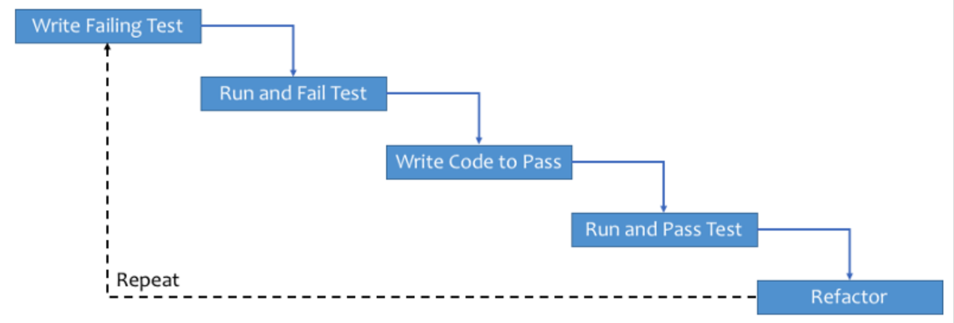
Test Driven Development-General work flow
A Process where the Developer takes responsibility of the Quality of their code
Unit tests are written before the production code.
Don’t write all tests at once
Tests and Production code are written in small bits of functionality
TDD is a XP process and created by Ken Buck.
https://www.freecodecamp.org/news/learning-to-test-with-python-997ace2d8abe/

Slide 32
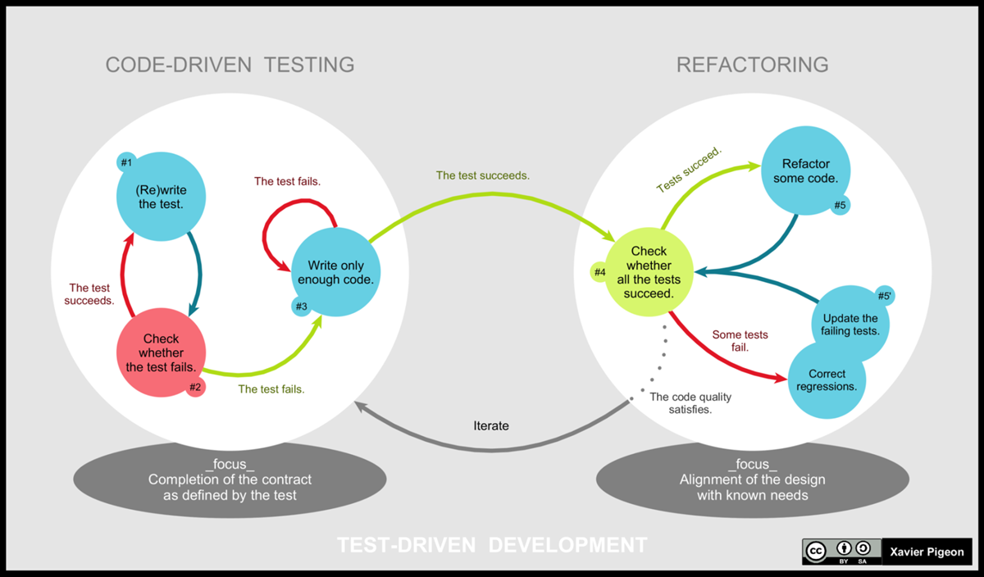
Test Driven Development (TDD) – Detail Process
Tools:
Junit for Java
Pyunit for Python
Test Driven Development Steps
Benefits:
Improves Code quality
Shortens feedback loop
Shorten Development time
TDD is part of Agile Culture

Slide 33
“Hello World” TDD Example
File mytests.py
import unit test from mycode import *
class MyFirstTests(unittest.TestCase):
def test_hello(self):
self.assertEqual(hello_world(), 'hello world')
1.File mycode.py
def hello_world():
Run mytest.py
Test fails . No return value.
2. Then Add code to mycode.py
def hello_world(): return 'hello world‘
Run mytest.py
Test Pass.
https://www.freecodecamp.org/news/learning-to-test-with-python-997ace2d8abe/

Slide 34
Quiz
S2

Slide 35
Lean Software Development
Source: Lynda.com :DevOps Foundations: Lean and Agile with Ernest Mueller and Karthik Gaekwad

Slide 36
What is Lean?
Lean is a systematic method to eliminate waste and maximize the flow of value through a system. Value is defined as something your customer will pay money for.
Lean employs something called Value stream mapping.
This practice is widely used in Manufacturing world.

Slide 37
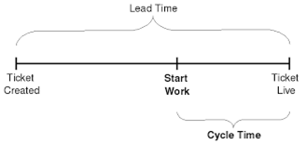
Lead time & Cycle Time
Lead time tracks the total amount of time it takes from when work is requested until it's delivered.
Cycle time tracks the amount of time we spend working on it. (Also called Processing time or Throughput time)

Slide 38
Value Stream Mapping
Value is defined as something your customer will pay money for.
Value Stream Mapping practice generates a diagram that shows the exact places where value is created in your system and how it flows through your organization.

Slide 39
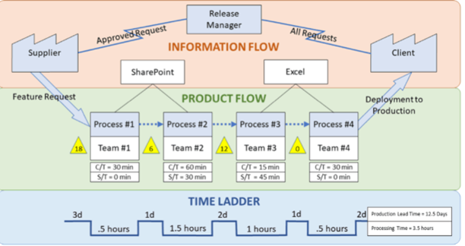
Example-Value stream Mapping- Initial State
Current State of SW Development
Source: https://www.plutora.com/blog/value-stream-mapping

Slide 40
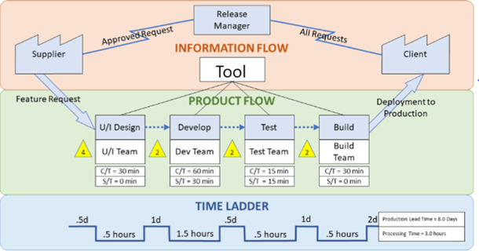
Example-Value stream Mapping – Future state
Future State of SW Development – Value is added
https://www.plutora.com/blog/value-stream-mapping

Slide 41
7 Principles of Lean Software Development

Slide 42
1. Eliminate Waste
Type of waste in SW Development
Unnecessary code or functionality: Delays time to customer, slows down feedback loops
Starting more than can be completed: Adds unnecessary complexity to the system, results in context-switching, handoff delays, and other impediments to flow
Delay in the software development process: Delays time to customer, slows down feedback loops
Unclear or constantly changing requirements: Results in rework, frustration, quality issues, lack of focus
Bureaucracy: Delays speed
Slow or ineffective communication: Results in delays, frustrations, and poor communication to stakeholders which can impact IT’s reputation in the organization

Slide 43
2. Build Quality In
Pair programming: Avoid quality issues by combining the skills and experience of two developers instead of one
Test-driven development: Writing criteria for code before writing the code to ensure it meets business requirements
Incremental development and constant feedback
Minimize wait states: Reduce context switching, knowledge gaps, and lack of focus
Automation: Automate any tedious, manual process or any process prone to human error

Slide 44
3. Create Knowledge
Pair Programming
Code reviews
Documentation
Wiki – to let the knowledge base build up incrementally
Chat, Chatops
Thoroughly commented code
Knowledge sharing sessions
Training
Use tools to manage requirements or user stories

Slide 45
4. Defer Commitment
Don’t make decision/commit if you can differ it at later point in time. Keep options open.
Continuously collect and analyze the data or information

Slide 46
5. Deliver Fast
Build a simple solution.
Put it in front of customers
Enhance incrementally based on customer feedback.
Speed to market is an incredible competitive advantage esp. for Software.
What slows them down?
Thinking too far in advance about future requirements
Blockers that aren’t responded to with urgency
Over-engineering solutions and business requirements

Slide 47
6. Respect People
Communicating proactively and effectively
Encouraging healthy conflict
Surfacing any work-related issues as a team (Blameless postmortem)
Empowering each other to do their best work.

Slide 48
7.Optimize the Whole
Value Stream mapping
System thinking
Operating with a better understanding of capacity and the downstream impact of work.

Slide 49
Lean Principles that are Proven to Work
Small deliverables
Limiting work in progress
Information radiators and visibility into flow,
Gathering, broadcasting and implementing customer feedback
Empowered development teams who are free to experiment and improve.

Slide 50
Kanban

Slide 51
Kanban
Taiichi Ohno, who was an industrial engineer at Toyota, developed the Kanban methodology in 2004 to improve efficiency at the manufacturing plant.
The Kanban method is an approach to continuously improving service delivery that emphasizes the smooth, fast flow of work.
Kanban is not an Agile software development method (or process) or a software engineering methodology
Kanban is flow based methodology and a pull system.
Kanban does not prescribe specific roles or process steps as it is built on the concept of evolutionary change.

Slide 52
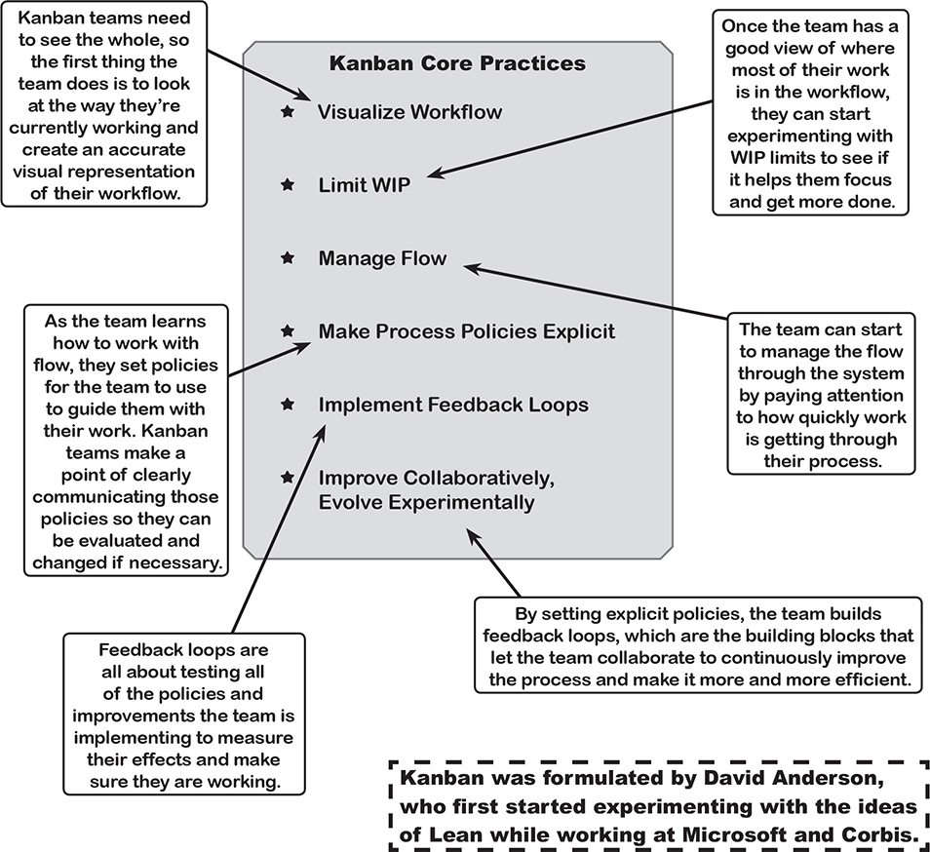


Slide 53
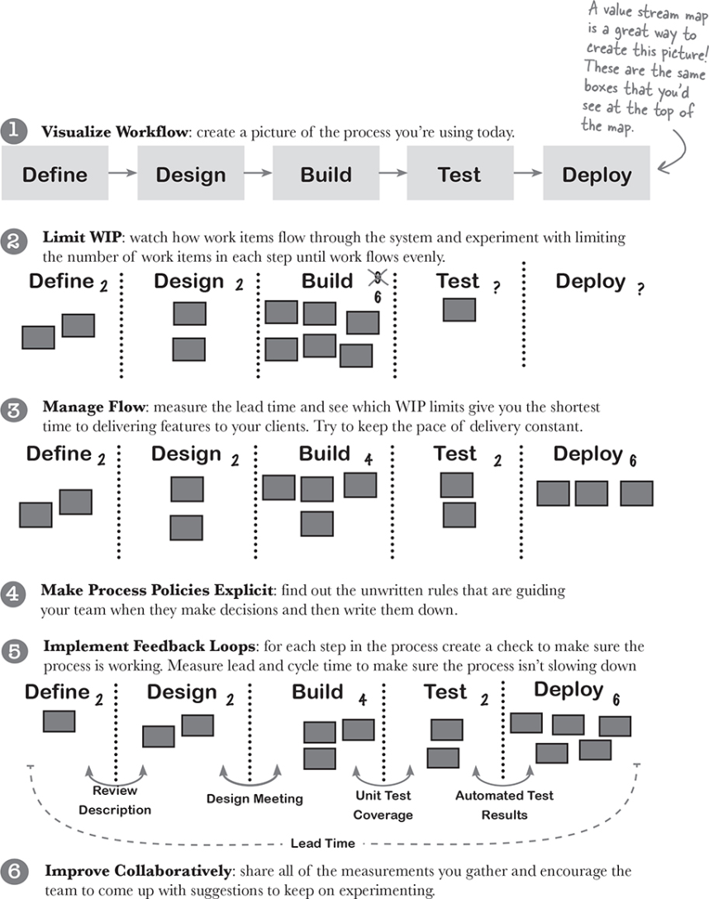
How to use Kanban to improve your process
Source: Head First Agile by Jennifer Greene; Andrew Stellman,
Published by O'Reilly Media, Inc., 2017

Slide 54
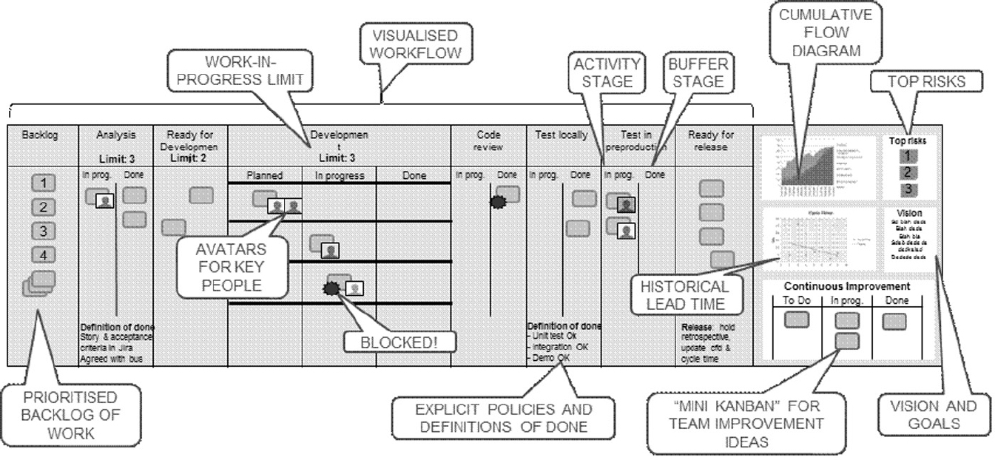
Typical Kanban board
Source: Agile Foundations - Principles, practices and frameworks, by Peter Measey
Published by BCS Learning & Development Limited, 2015

Slide 55
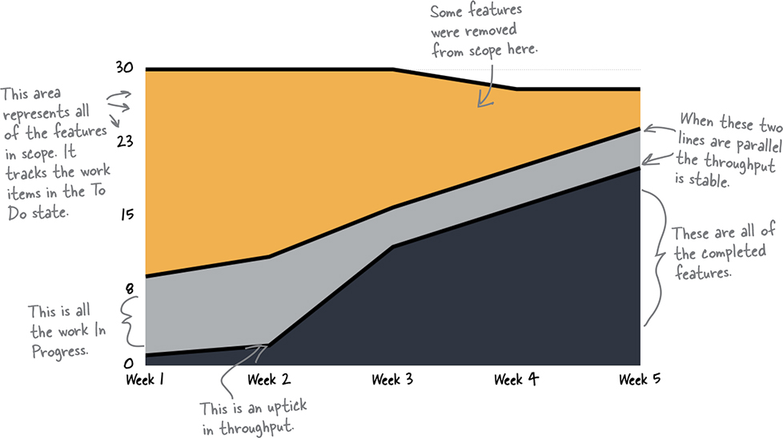
Cumulative flow diagram (Example-1)
Kanban teams use cumulative flow diagrams (or CFDs) to find out where they are systematically adding waste and interrupting their flow.
Source: Head First Agile by Jennifer Greene; Andrew Stellman,
Published by O'Reilly Media, Inc., 2017

Slide 56
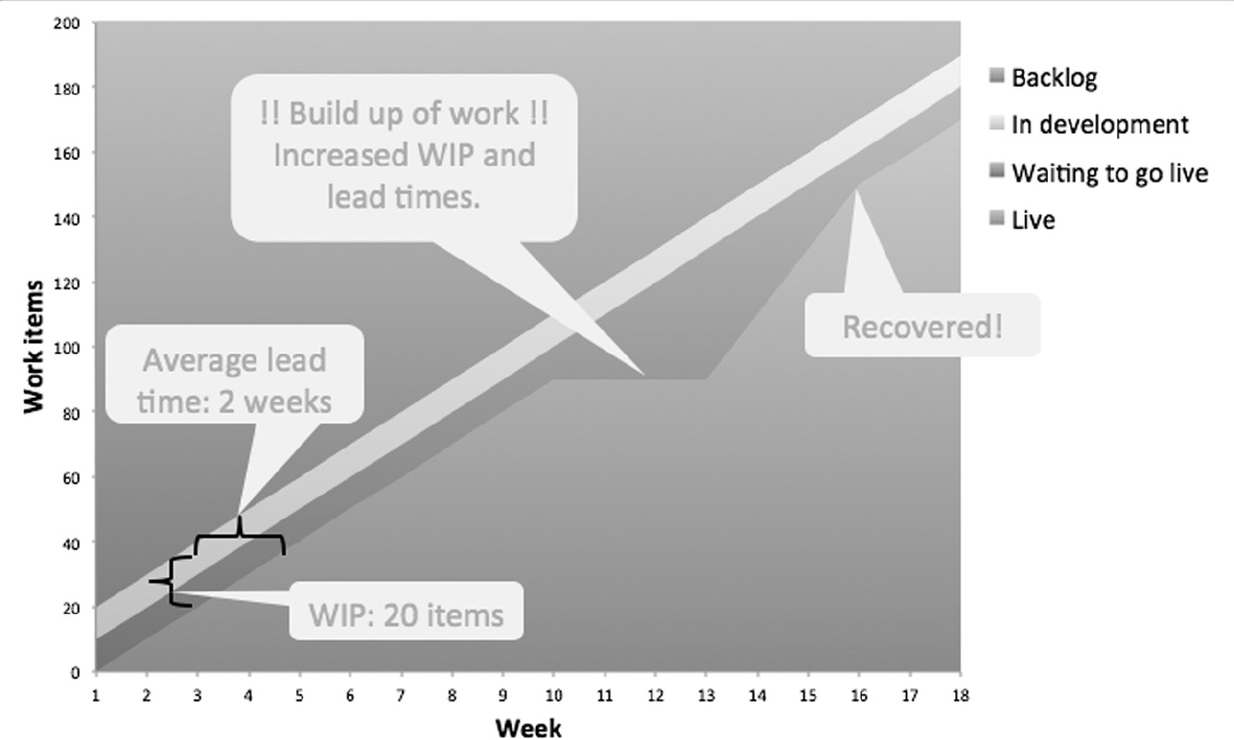
Cumulative flow diagram (Example-2)
Source: Agile Foundations - Principles, practices and frameworks, by Peter Measey
Published by BCS Learning & Development Limited, 2015

Slide 57
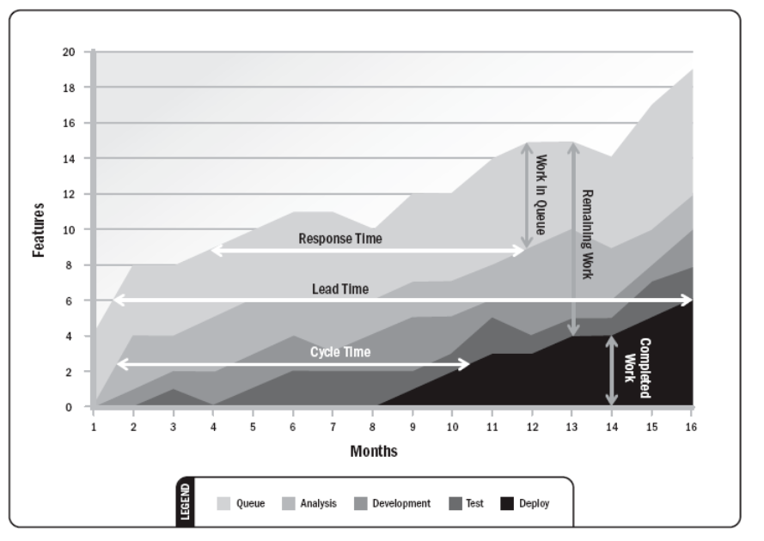
Cumulative flow diagram (Example-3)

Slide 58
Quiz
S3

Slide 59
Thank you

